Slide 1
Effectiveness of Performance Appraisal
Student’s Name
Institutional Affiliation

Slide 2
Preview/Outline
Introduction
Effective Performance Appraisal
  Dialogue Method of Evaluation
Conclusion

Slide 3
INTRODUCTION
Companies are responsible for helping their workers in improving the quality as well as the quality of their work, or at least help the employee to meet the expectations of the company.
It is expensive for an organization to pay severance to a terminated employee and then bear costs of seeking and hiring a new staff member.

Slide 4
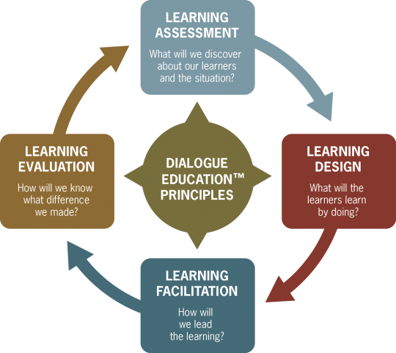
EFFECTIVE PERFORMANCE APPRAISAL
Effective Performance Appraisal depends on how the organizations establishes a system that works for both the management and employees.
A dialogue system would be effective in ensuring that employees address available problems as soon as they erupt. The employees and the workers are expected to have a periodical communication in order to reach the companies objectives

Slide 5
Conclusion
In order to promote effectiveness, a dialogue system of evaluation should be established in which supervisors can use in evaluating performance.
The system helps employees in discussion problems that erupt within the organization.
Poor connections with employees can result in poor relations with the organization in genera

